Slide 1
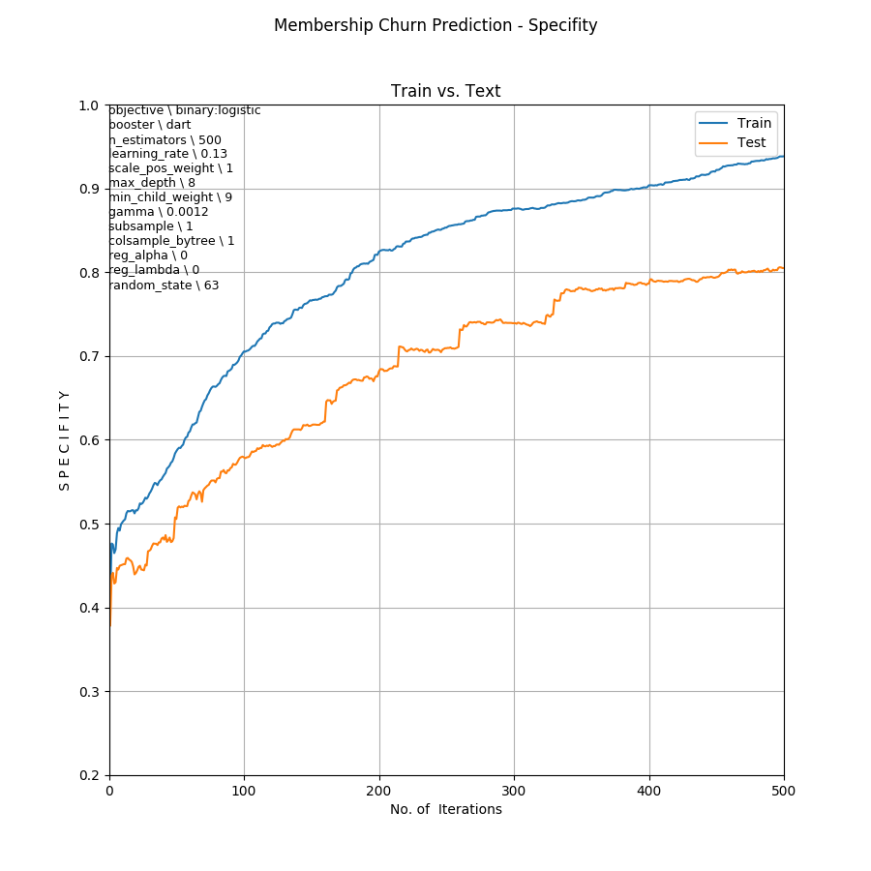
Membership Churn Prediction
S e n s I t I v I t y / R e c a l l
Number of Iterations

